Slide 1
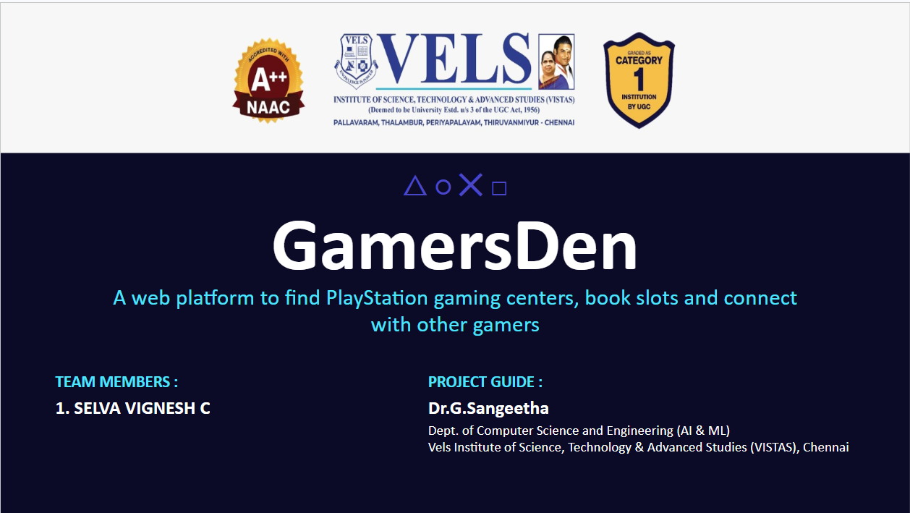

Slide 2
Introduction
Problem
Solution
Gamers may find it difficult to locate nearby gaming centres, compare prices and know which sessions are available.
GamersDen brings centre discovery, session information and booking into one website.
Main aim
• Help users find gaming centres and view their details.
• Allow users to check sessions and book a player slot.
• Give centre owners tools to manage consoles, prices and sessions.
2

Slide 3
Abstract
GamersDen is a web-based platform designed to make local gaming-centre discovery and booking easier. Users can search for centres, view available information and book gaming sessions. Centre owners can manage their centre profile, location, consoles, games, prices and published sessions through an owner dashboard. The system uses React for the frontend, Django REST Framework for backend APIs and MySQL for data storage. The goal is to provide a simple, central place for gamers and centre owners to coordinate sessions.
Users
Owners
Technology
Discover centres and book sessions
Manage consoles, prices and sessions
React • Django REST • MySQL
3

Slide 4
Literature Review
Related work on online booking systems
Online reservation
Availability calendars
Owner management
Research on sports-facility booking describes replacing calls and manual records with online reservations.
Slot visibility and calendar-based scheduling help users choose a suitable time and can reduce booking conflicts.
Management dashboards help facility providers track reservations and organise their resources.
Research gap addressed by GamersDen
The base paper focuses on sports turf reservations. GamersDen adapts the booking idea to PlayStation gaming centres, including consoles, games, prices, centre locations and owner tools.
4

Slide 5
Base Paper
“Turf Booking System: Simplifying Sports Facility Reservations”
Sanjukta Chatterjee, Avijit Dey, Arya Bhowmick, Arindom Ghosh and Anubhav Deb
International Journal for Multidisciplinary Research (IJFMR), Volume 7, Issue 3, May–June 2025
Main idea
How it supports GamersDen
A web-based system for viewing available slots, selecting a time and booking sports facilities.
It provides a reference for online availability, calendar scheduling, user management and owner-side booking administration.
DOI: 10.36948/ijfmr.2025.v07i03.44829
5

Slide 6
System Architecture
Frontend
Backend API
Database
React website
• Discover centres
• Booking screens
• Owner dashboard
REST / JSON
Django REST Framework
• Authentication
• Centre and console data
• Session and booking logic
Queries
MySQL
• Users and roles
• Centres and consoles
• Sessions and bookings
Basic workflow
1
User action
2
API request
3
Database read/write
4
Response shown
6

Slide 7
Project Modules
1. User Authentication
2. Centre Discovery
3. Console & Game Management
Sign up, log in and use role-based access.
Search centres and view location and details.
Owners add consoles, games, capacity and prices.
4. Session Availability
5. Booking Management
6. Owner Studio
Owners publish sessions with start time and duration.
Users book slots and review their bookings.
Owners manage centre visibility, map location and inventory.
7

Slide 8
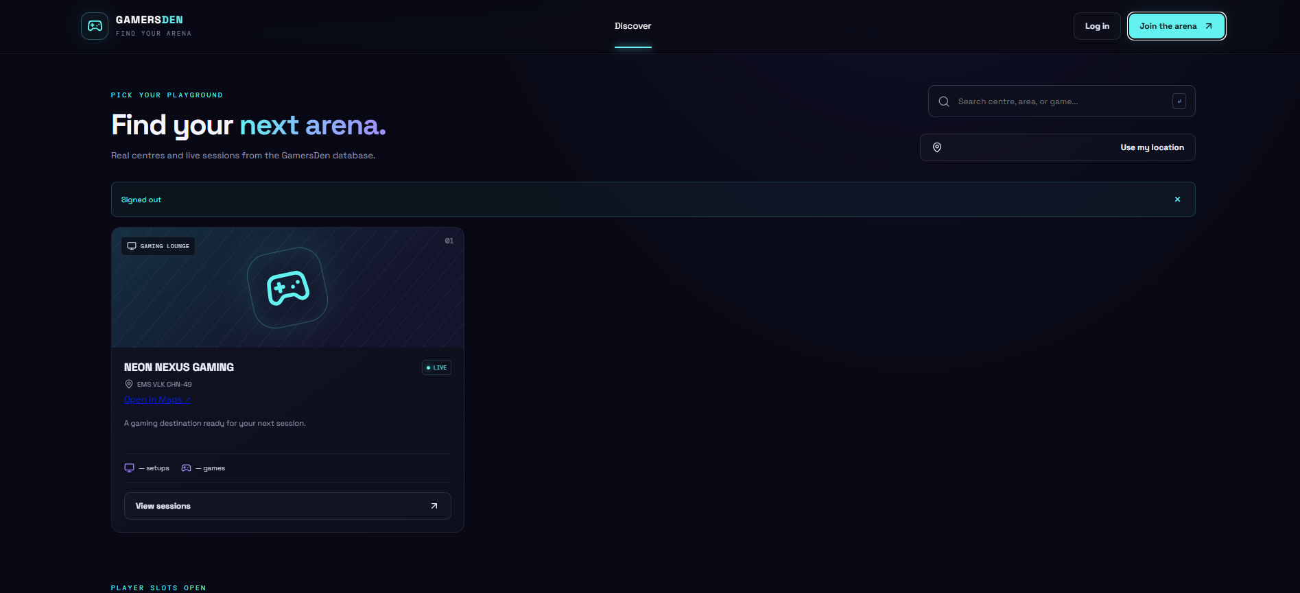
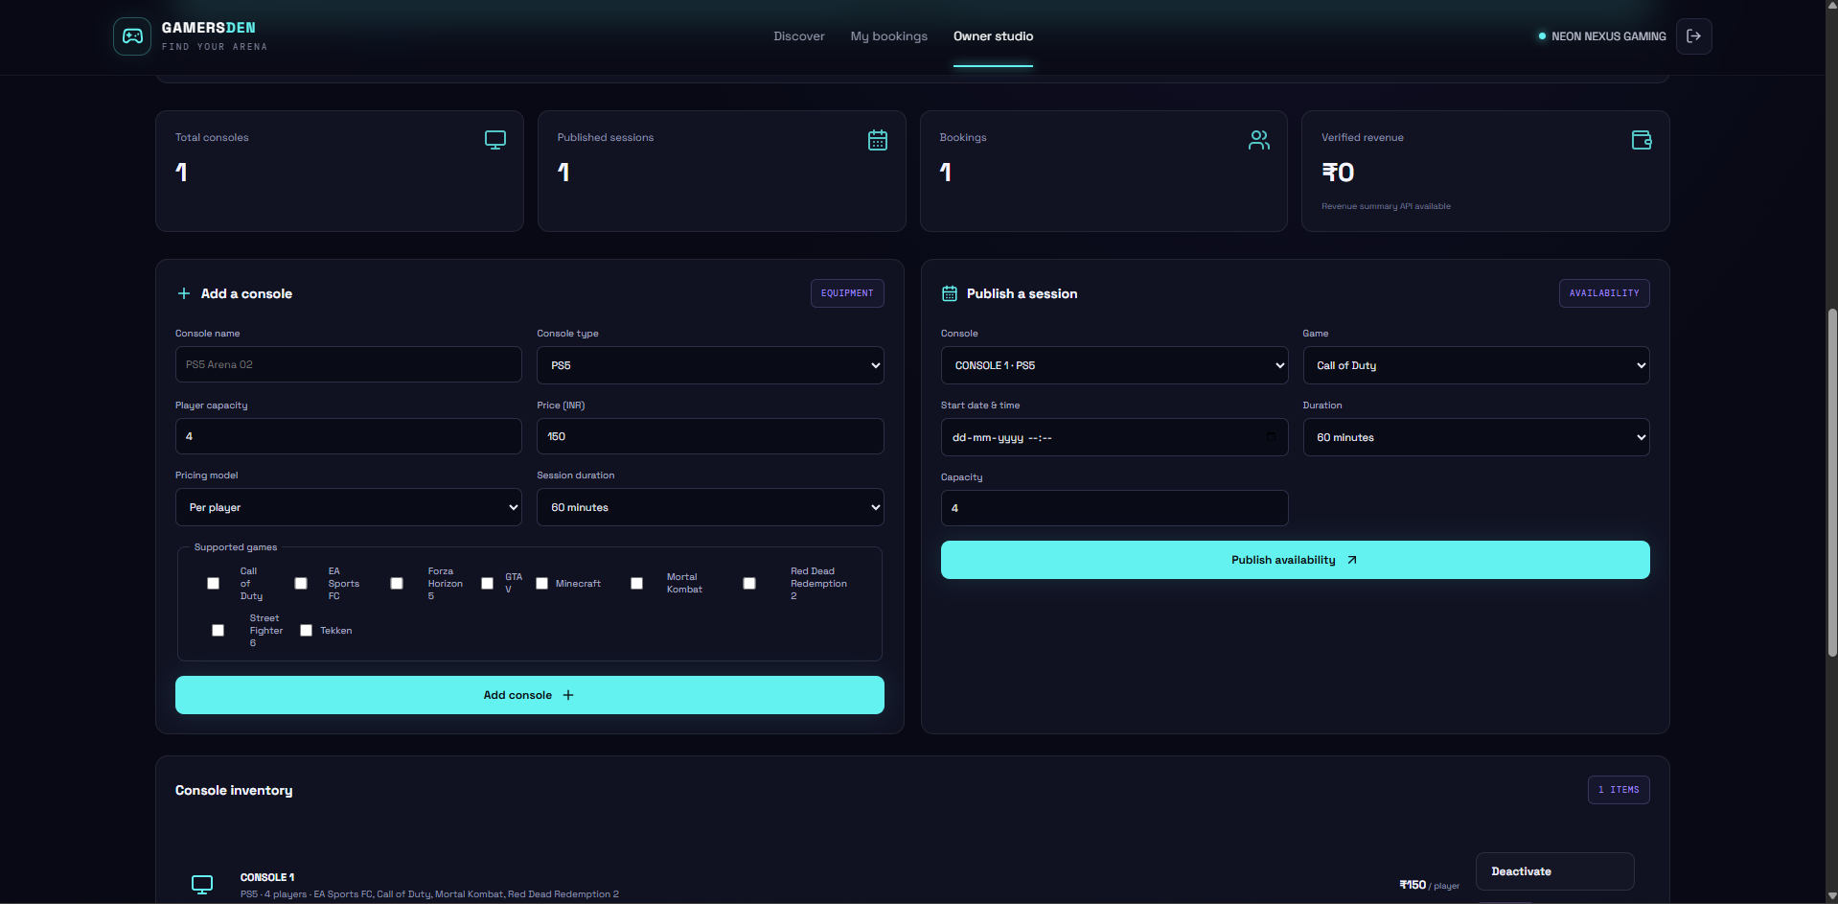
How the Modules Work
Gamer side: search and centre listing
Owner side: inventory and availability
• Search for a centre or game.
• View centre details and map directions.
• Open the sessions section to continue booking.
• Add consoles and select supported games.
• Set player capacity, pricing and duration.
• Publish sessions for users to discover.
8

Slide 9
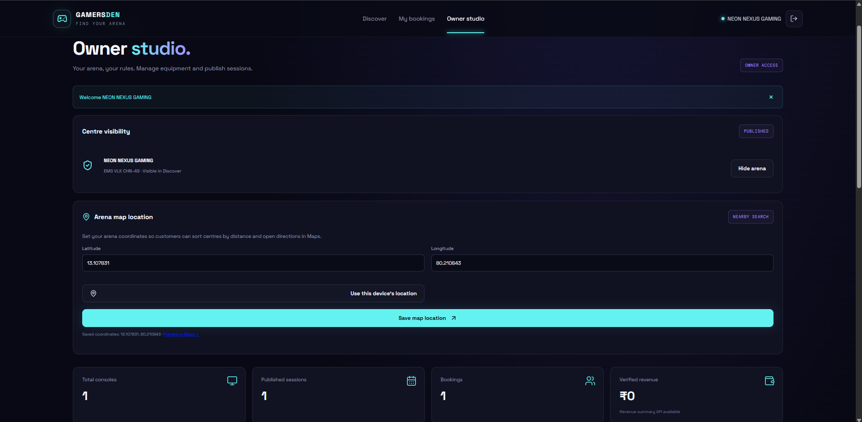
Results and Current Status
What the current prototype demonstrates
• Home page and gaming-centre discovery screen are available.
• Owner Studio includes centre visibility and map-location fields.
• Console inventory and session-publishing forms are present.
• The dashboard displays session and booking summary counts.
Next improvements
Test availability and booking end-to-end, verify payment flow, improve error handling and prepare deployment.
9

Slide 10
References
1. Chatterjee, S., Dey, A., Bhowmick, A., Ghosh, A., & Deb, A. (2025). Turf Booking System: Simplifying Sports Facility Reservations. International Journal for Multidisciplinary Research, 7(3), May–June 2025.
https://www.ijfmr.com/papers/2025/3/44829.pdf
2. GamersDen project implementation and interface screenshots provided by the project developer.
Thank you
GamersDen — Find your arena
10

